Slide 1
RSV Antibodies
Note: Good summary can be found at
https://www.fda.gov/media/165733/download

Slide 2
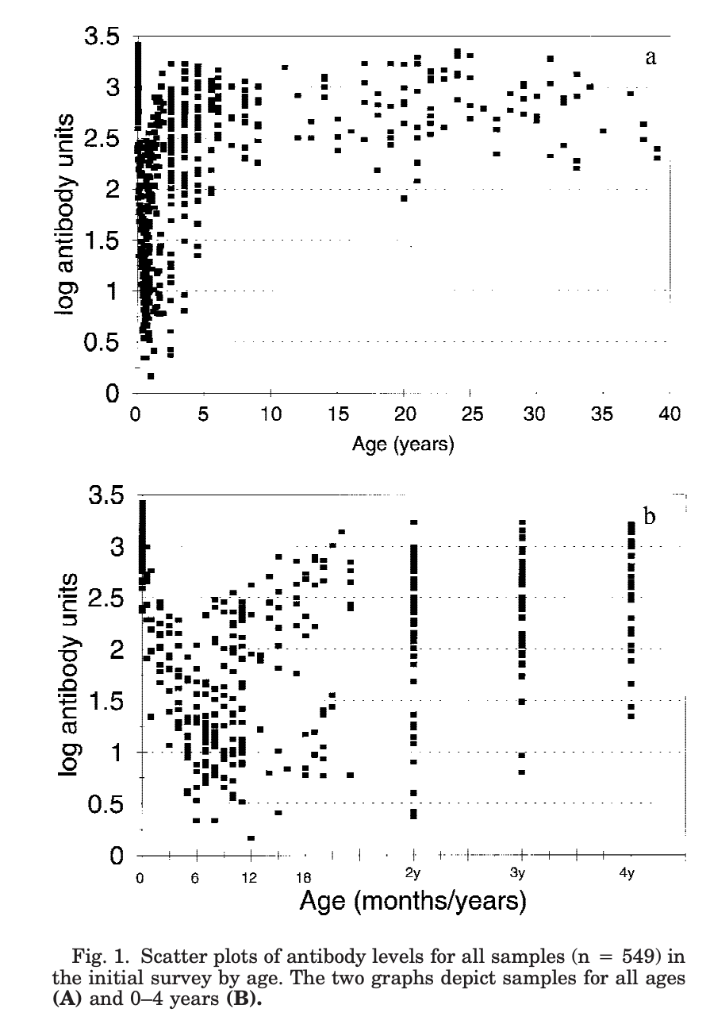
Antibodies in Infants
Maternal antibodies decay and then naturally acquired antibodies increase:
Cox, Journal of Medical Virology (1998) 55:234–239
Seroepidemiological Study of Respiratory Syncytial Virus in Sao Paulo State, Brazil
https://onlinelibrary.wiley.com/doi/pdf/10.1002/%28SICI%291096-9071%28199807%2955%3A3%3C234%3A%3AAID-JMV9%3E3.0.CO%3B2-2

Slide 3
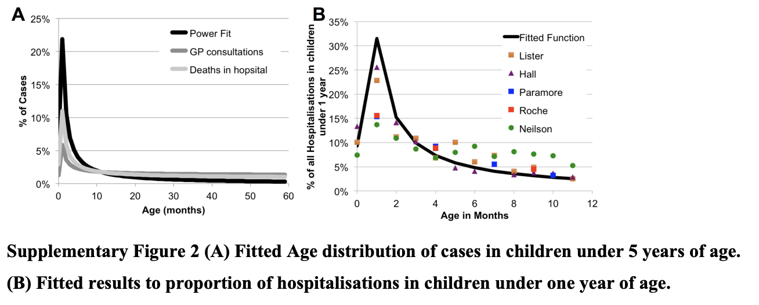
Antibodies in Infants
Proportion of hospitalized cases in children under 1-2 years disease doesn’t fit exactly with antibody distribution.
Cromer, Lancet ID (2017) 2(8) ppe367-e374
Burden of paediatric respiratory syncytial virus disease and potential effect of different immunisation strategies: a modelling and cost-effectiveness analysis for England
https://www.sciencedirect.com/science/article/pii/S2468266717301032

Slide 4
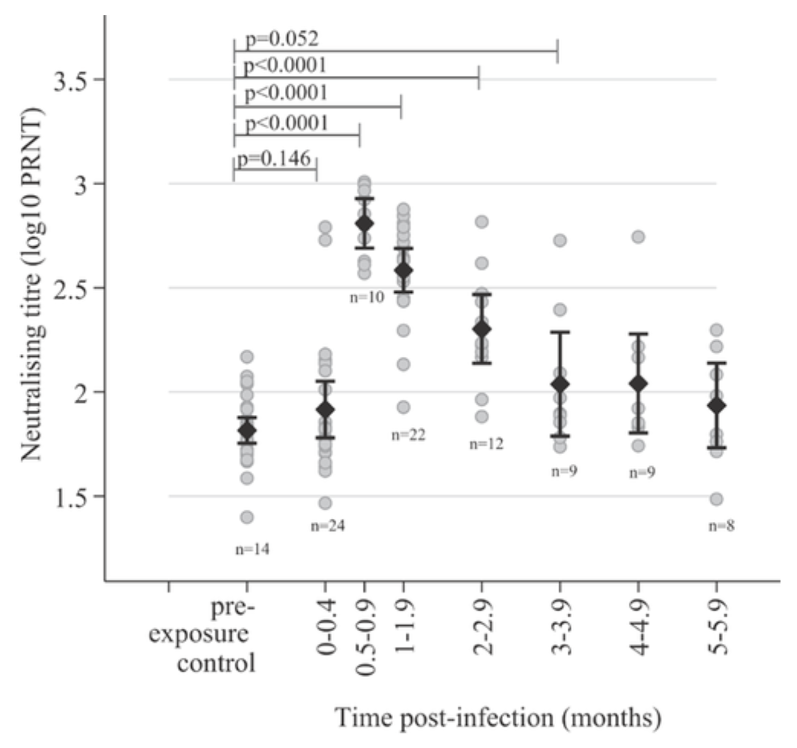
Antibodies in Infants (decay)
Naturally acquired Abs also decay quickly
Sande … Nokes, Journal of Medical Virology (2013) 85:2020–2025
Kinetics of the Neutralizing Antibody Response to Respiratory Syncytial Virus Infections in a Birth Cohort
https://onlinelibrary.wiley.com/doi/full/10.1002/jmv.23696
Figure 1: Antibodies in Infants

Slide 5
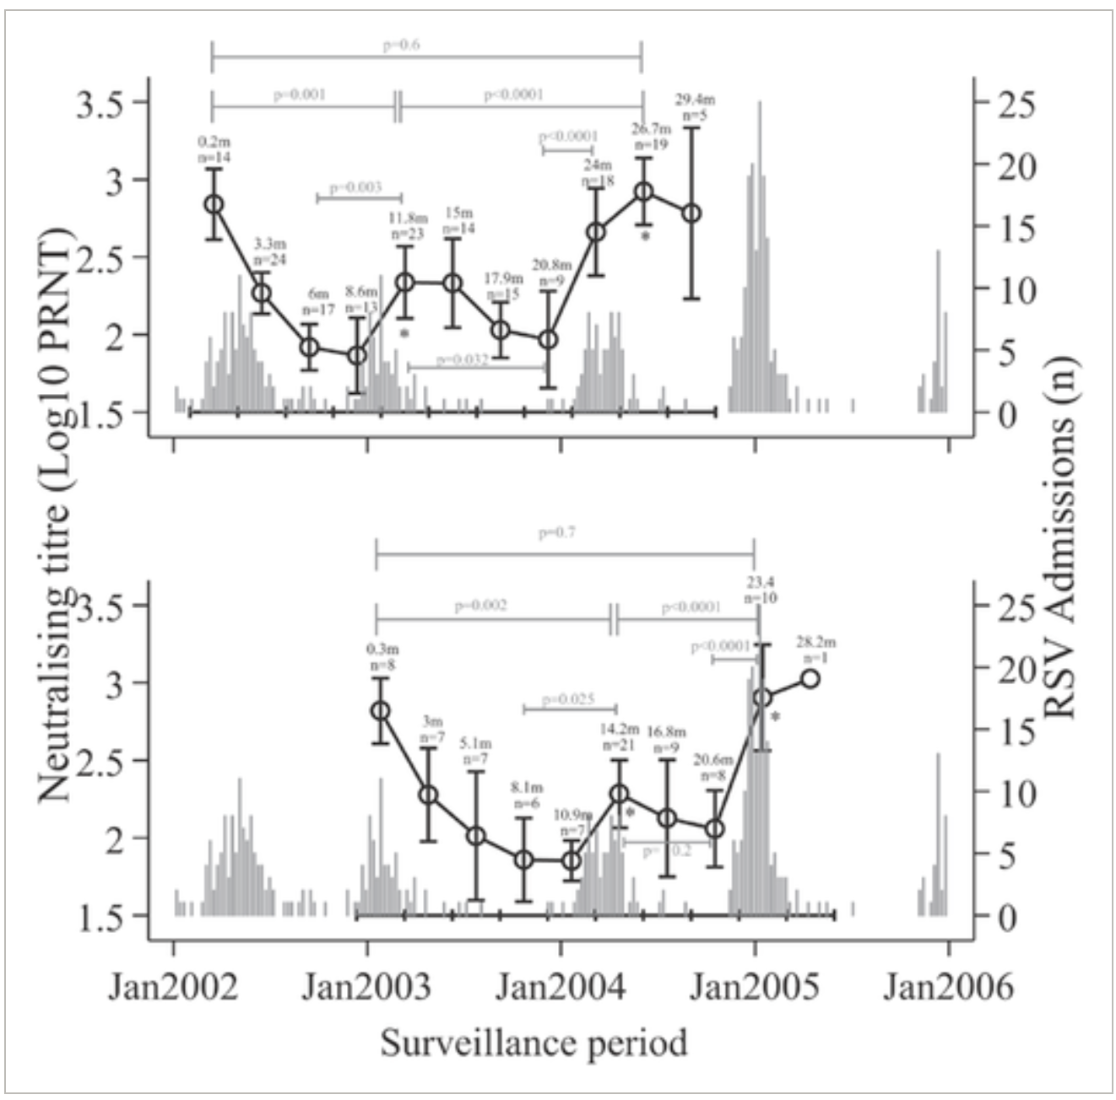
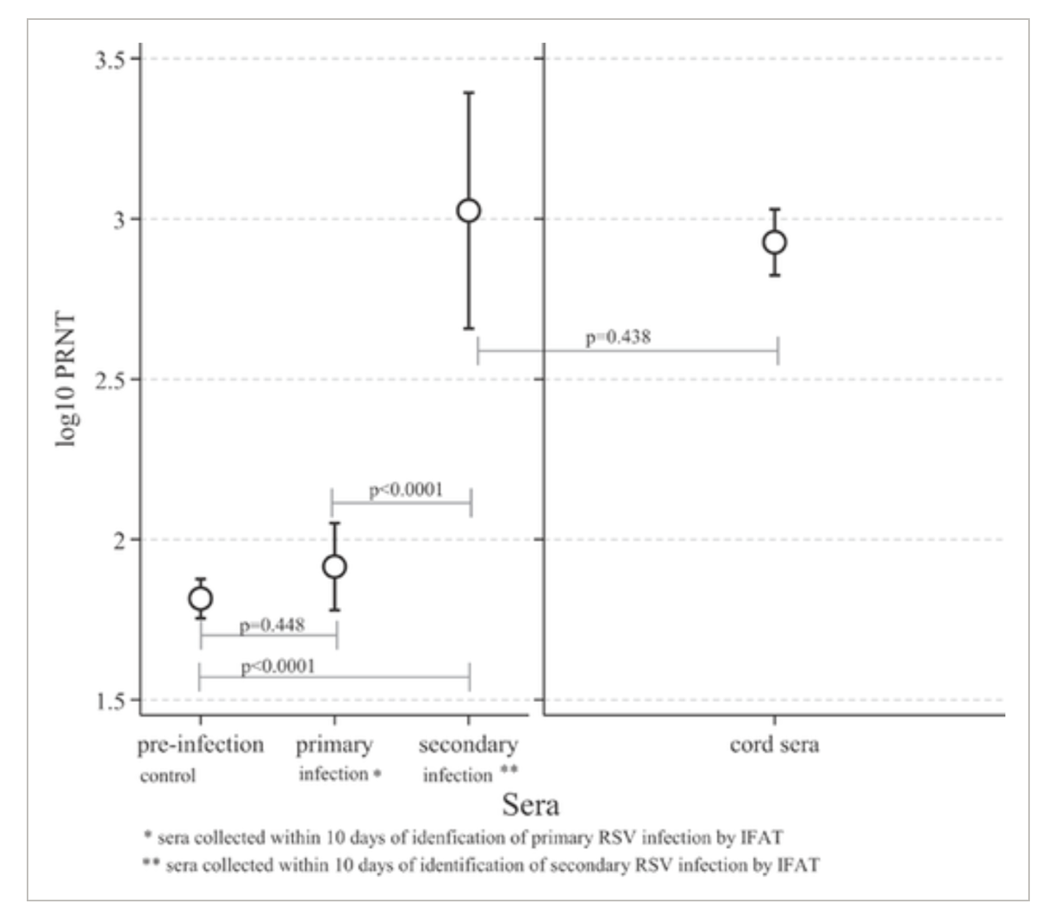
Antibodies in Infants
Takes a couple of infections to get back to birth antibody levels
Figure 2: Antibodies in Infants
Figure 2: Antibodies in Infants relative to RSV seasons
Sande … Nokes, Journal of Medical Virology (2013) 85:2020–2025
Kinetics of the Neutralizing Antibody Response to Respiratory Syncytial Virus Infections in a Birth Cohort
https://onlinelibrary.wiley.com/doi/full/10.1002/jmv.23696

Slide 6
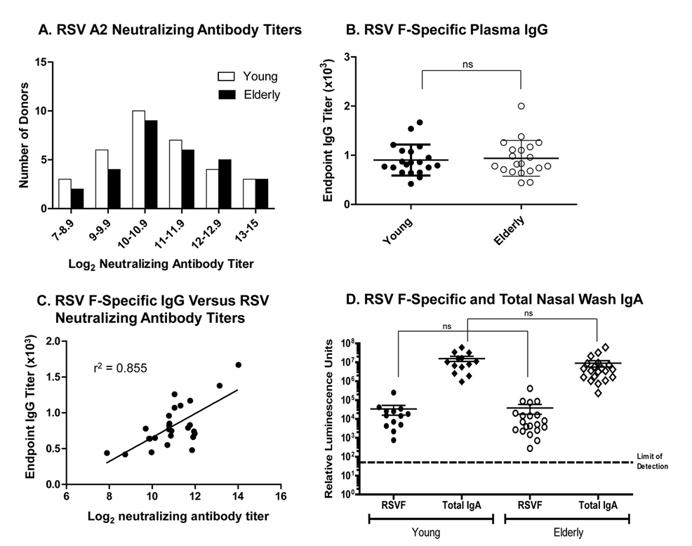
Antibodies in Adults
Does not seem to be a big difference in Ab titres between young and older adults
Cherukuri CVI, (2012) 20(2) pp 239-247
Adults 65 Years Old and Older Have Reduced Numbers of Functional Memory T-cells to Respiratory Syncytial Virus Fusion Protein
https://journals.asm.org/doi/10.1128/cvi.00580-12
Figure 1: Abs in young vs old adults

Slide 7
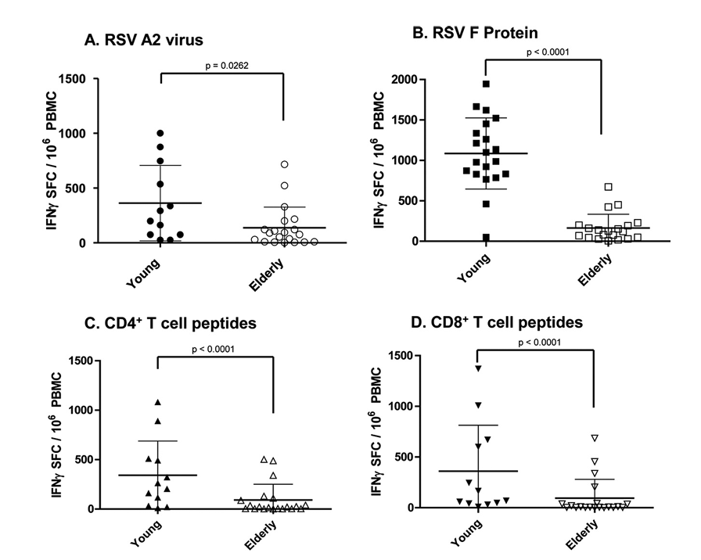
Antibodies in Adults
However there are differences in RSV specific T-cells
Cherukuri CVI, (2012) 20(2) pp 239-247
Adults 65 Years Old and Older Have Reduced Numbers of Functional Memory T-cells to Respiratory Syncytial Virus Fusion Protein
https://journals.asm.org/doi/10.1128/cvi.00580-12
Figure 3: PBMC stimulated ex-vivo using
A) wt RSV A2 at 1 PFU/10 cells
B) 5 µg/ml of RSV F protein
C) 2 µg/ml of RSV F-specific CD4⁺ T cell peptide pools
D) 2 µg/ml of RSV F-specific CD8⁺ T cell peptide pools

Slide 8
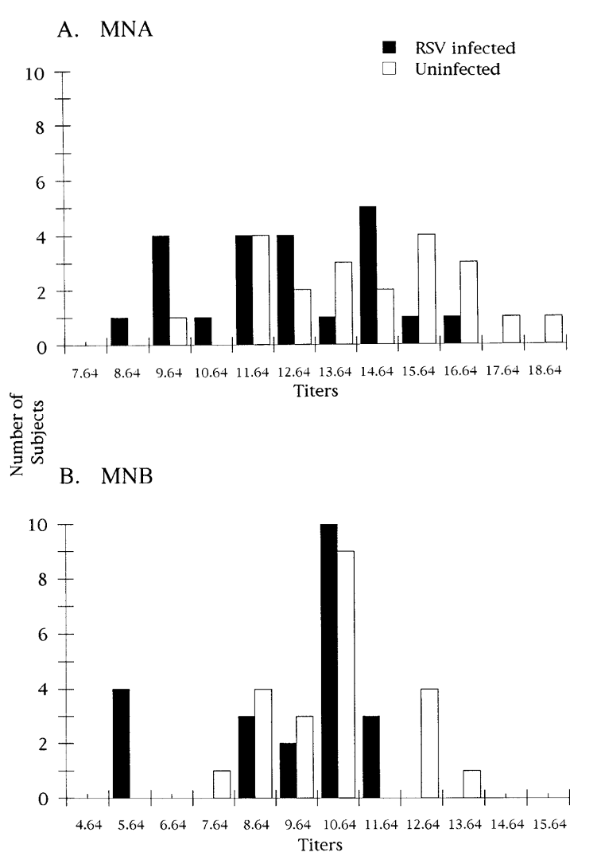
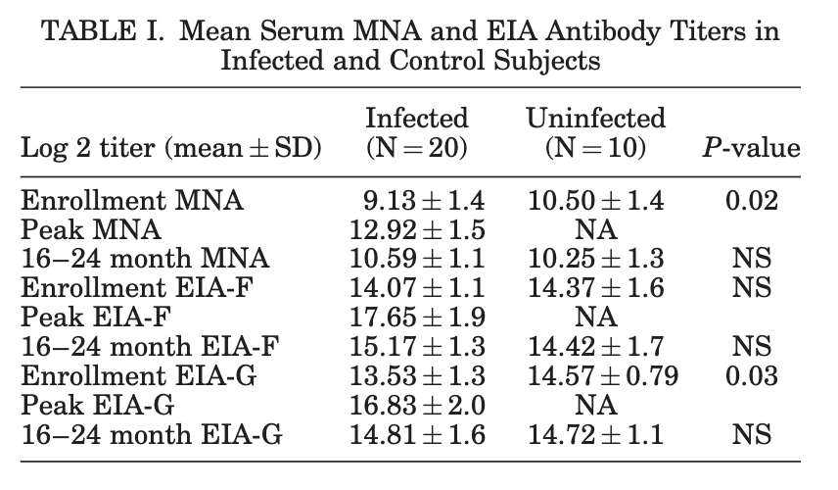
Antibodies in Adults
Adults who get RSV seem to have lower AB titres
Falsey&Walsh JID, 177(2) (1998) pp 463–466
Relationship of Serum Antibody to Risk of Respiratory Syncytial Virus Infection in Elderly Adults
https://academic.oup.com/jid/article/177/2/463/925432
Falsey&Walsh Journal of Medical Virology (2006), 78(11) pp 1493-1497
Serum antibody decay in adults following natural respiratory syncytial virus infection
https://onlinelibrary.wiley.com/doi/10.1002/jmv.20724
Figure 1: Ab titres by RSV status

Slide 9
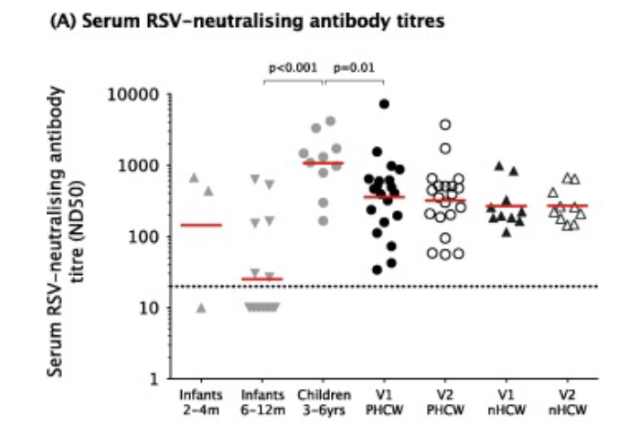
Antibodies in Adults (decay)
May not decay as much over time
Green … Pollard Vaccine (2018) 36(41) pp6183-6190
Humoral and cellular immunity to RSV in infants, children and adults
https://www.sciencedirect.com/science/article/pii/S0264410X1831185X
Figure 1: Antibodies
V1 is at end of RSV season, V2 is 4-6 months later

Slide 10
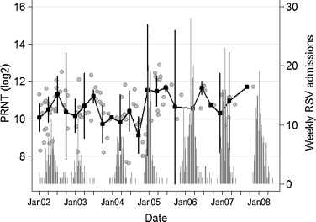
Antibodies in Adults (decay)
This is contradicted by the fact that the maternal antibodies in cord blood change relative to the RSV season
Nyiro, Vaccine (2015) 33(15) p1797-1801
Quantifying maternally derived respiratory syncytial virus specific neutralising antibodies in a birth cohort from coastal Kenya
https://www.sciencedirect.com/science/article/pii/S0264410X15002285
Figure 4: Dynamics of cord titres by time and transmission intensity.

Slide 11
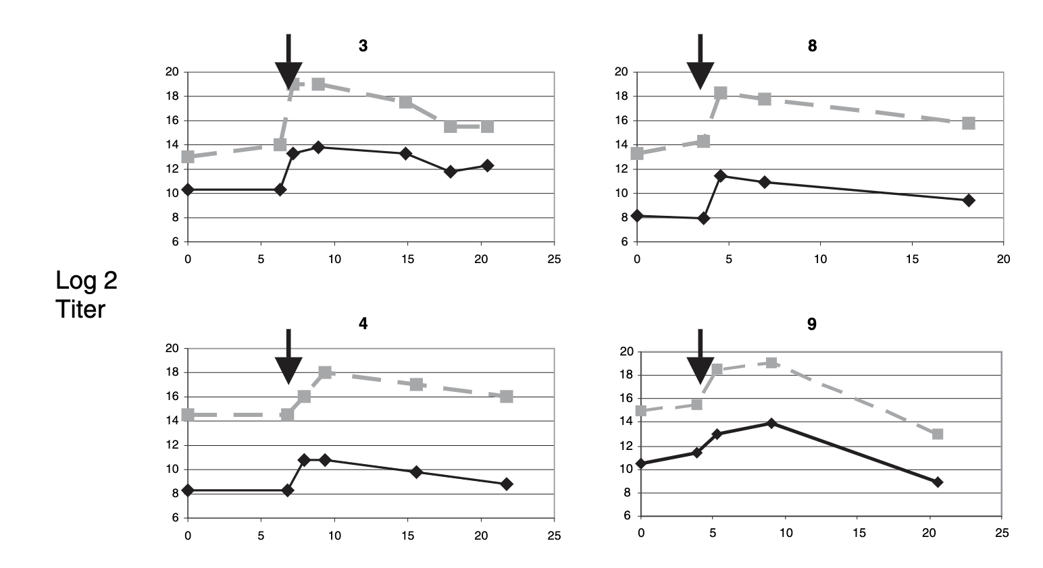
Antibodies in Adults (decay)
Direct measurement of Abs suggests they decay after infection.
Falsey&Walsh Journal of Medical Virology (2006), 78(11) pp 1493-1497
Serum antibody decay in adults following natural respiratory syncytial virus infection
https://onlinelibrary.wiley.com/doi/10.1002/jmv.20724
Figure 1: Example Ab decay after infection in adults
(decay rate of -0.2 +/- .23 log2 units / month, t_{1/2}=3.5 months)
Black line: MNA titers gray broken line: EIA F titers. Arrow indicatea time of RSV infection.

Slide 12
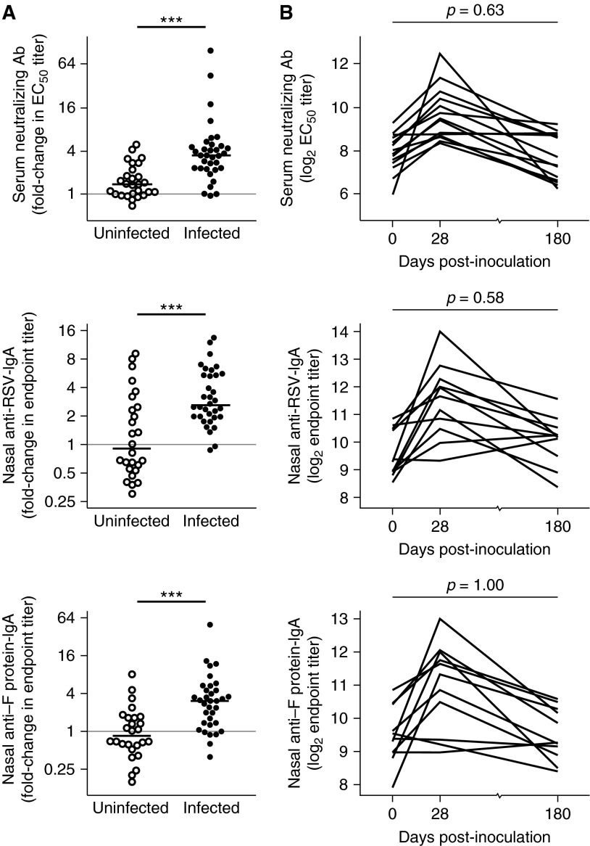
Ab Decay in Human Challenge Studies
Antibodies increase after infection, but decrease quickly (contradicting the idea that they don’t decay)
Habibi MS, Am J Respir Crit Care Med, 2015
Impaired Antibody-mediated Protection and Defective IgA B-Cell Memory in Experimental Infection of Adults with Respiratory Syncytial Virus
https://www.atsjournals.org/doi/10.1164/rccm.201412-2256OC
Figure 2

Slide 13
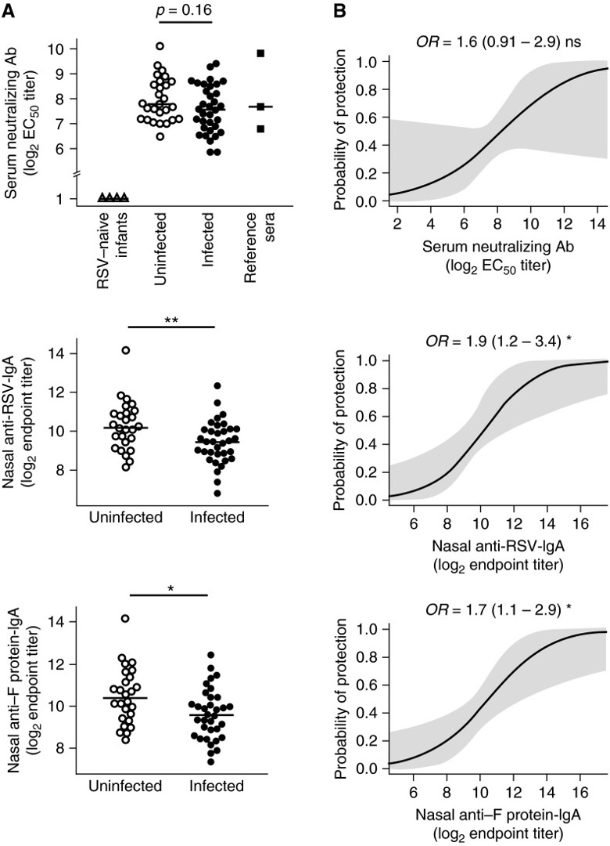
Human Challenge Studies
Antibodies might not be the best correlate of protection from acquisition of infection.
Human Challenge of healthy individuals, 34/61 (56%) became infected, 23/34 (68%) symptomatic.
Infection diagnosed by PCR positivity on 2 consec days.
Habibi MS, Am J Respir Crit Care Med, 2015
Impaired Antibody-mediated Protection and Defective IgA B-Cell Memory in Experimental Infection of Adults with Respiratory Syncytial Virus
https://www.atsjournals.org/doi/10.1164/rccm.201412-2256OC
Figure 1

Slide 14
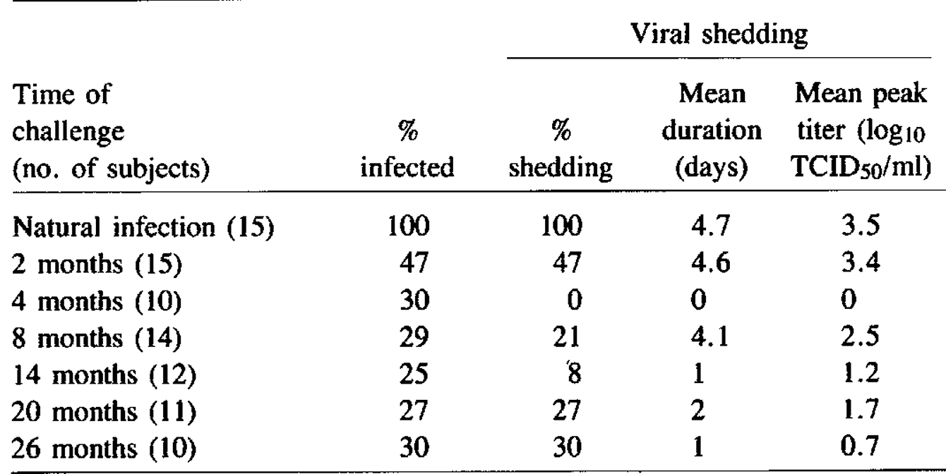
Human Challenge Studies
Natural infection does not provide full protection against reinfection.
In a study where subjects were repeatedly challenged with RSV, many of them became reinfected (defined by 4-fold ab ↑ OR isolation)
Hall JID (1991) 163:693-698
Immunity to and Frequency of Reinfection with Respiratory Syncytial Virus
https://academic.oup.com/jid/article-abstract/163/4/693/944323
Table 1: Proportion infected as detected by viral isolation or antibody rise.

Slide 15
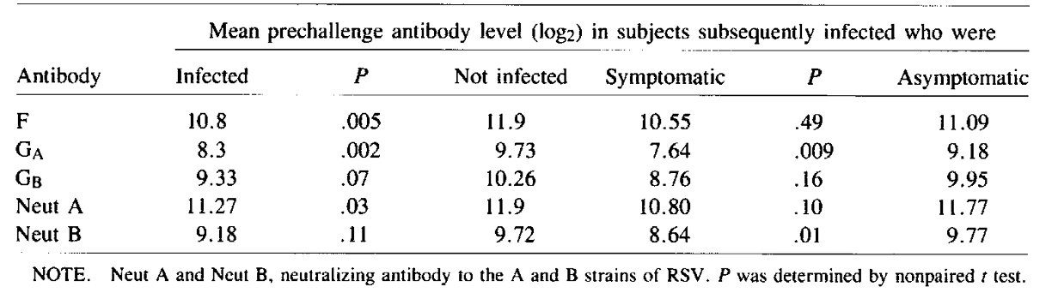
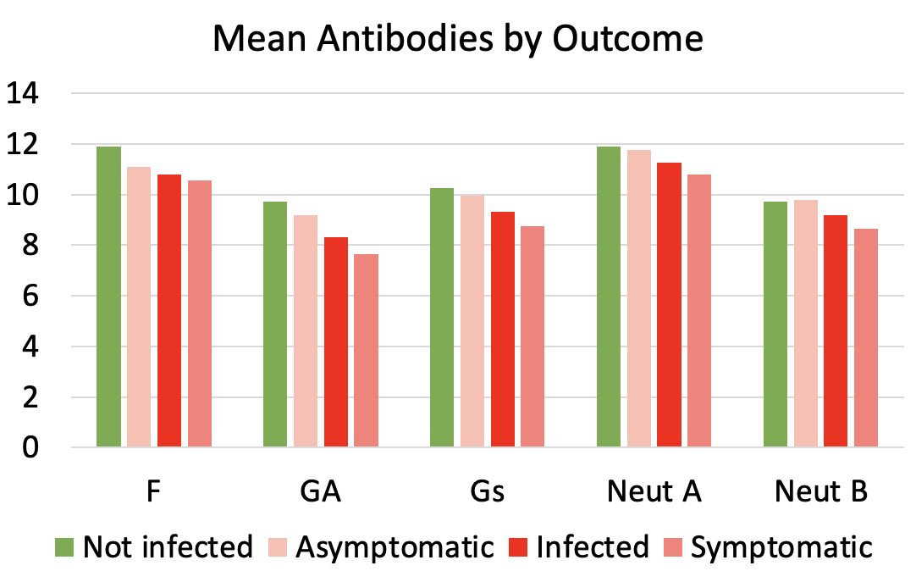
Human Challenge Studies
Antibodies correlate with both infection and symptoms
Table 3: Antibody levels
Hall JID (1991) 163:693-698
Immunity to and Frequency of Reinfection with Respiratory Syncytial Virus
https://academic.oup.com/jid/article-abstract/163/4/693/944323

Slide 16
Vaccine induced Antibodies
Antibodies seem to decay faster in infants

Slide 17
Vaccine induced Antibodies
This is supported by decay rate calculations

Slide 18
Vaccine Effectiveness
Some correlation between antibodies and effectiveness.

Slide 19
Questions
Is the decay of naturally acquired and vaccine induced / passive antibodies similar?
Are neutralizing antibodies the best correlate of protection? Is IgG, RSV-preF, something else better?
Is the relationship between antibodies and effectiveness the same for infants and adults? For vaccines and passive antibodies?

